Slide 1
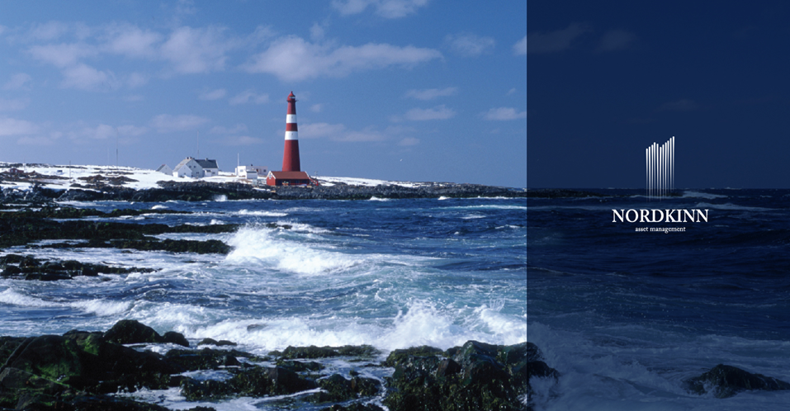
October 2015
Hedge Funds
NTNU

Slide 2

DISCLAIMER
This presentation shall not constitute an offer to sell or the solicitation of any offer to buy. The information contained in this confidential document («Presentation») has been prepared by Nordkinn Asset Management AB (the «Company»), registered in Sweden No. 556895-3375. All rights reserved. Information in this presentation are made only as at the date of this presentation unless otherwise stated and remain subject to change without notice. Nordkinn Fixed Income Macro Funds are regulated and approved by the Swedish FSA. Note that this Presentation is potentially subject to material updating, revision and further amendment.
This presentation provides information in summary form only and is not intended to be complete. It is not intended to be relied upon as advice to investors or potential investors and does not take into account the investment objectives, financial situation or needs of any particular investor. This Presentation should not be considered as the giving of investment advice by the Company or any of its shareholders, directors, employees or agents. Each party whom this Presentation is made available must make its own independent assessment of the Company after making such investigations and taking such advice as may be deemed necessary. Potential investors are therefore invited to proceed with a thorough due diligence process in collaboration with the Company.
The information contained herein has been prepared in good faith. However, to the maximum extent permitted by law, neither Nordkinn Asset Management AB, nor its related corporations (including Nordkinn Asset Management Oslo Branch, registered in Norway No. 999 136 354), directors, employees or agents, nor any other person, accept any liability, including, without limitation, any liability arising from fault or negligence, for any loss arising from the use of this presentation or its contents or otherwise in connection with it.
The presentation may contain forward-looking statements. Although the Company believes the expectations expressed in such forward-looking statements are based on reasonable assumptions, such statements are not guarantees of future performance and actual results. Actual results or developments may differ materially from those projected in forward-looking statements.
The content of this Presentation is not intended for any residents of the United States, U.S. Persons or any entity organized or incorporated under the laws of the United States.

Slide 3
TABLE OF CONTENTS/AGENDA
01
02
03
Fund industry and Hedge Funds
About Nordkinn Asset Management
Investment Cases & Examples

Slide 4
What’s an Investment Fund?
WHAT’S AN INVESTMENT FUND?
Legally regulated and professionally managed investment vehicle made up by a pool of funds from many investors. The purpose of the investment fund is to invest into the asset in accordance with the framework specified in the funds prospectus. Investment Funds are managed by a fund manager, and the manager charges a fee for this service.

Slide 5
Why Investment Funds?
WHY INVESTMENT FUNDS?
Benefits of investment funds
Diversification (Instantly spreads the investment across multiple assets)
Divisibility (Ability to investment/disinvest odd amounts fitting your needs)
Liquidity (Dependent on the
Professional Management (Don’t have to worry about “stock-picking”)
Economies of Scale (Cost sharing)
Disadvantages of Investment Funds
“Fund picking”, entrusting the fund manager with your investment
Edge, capabilities, results (past/expected) and fear of scam (ie. Madoff)
Cost
Selection Cost (cost associated with selecting the fund, ie. research, due diligence, etc.), Fees (Management cost), Monitoring cost

Slide 6
Difference between Mutual Funds and Hedge Funds?
WHAT’S THE DIFFERENCE BETWEEN A MUTUAL FUND AND A HEDGE FUND?
Both Mutual Funds and Hedge Funds fits the previous definition of an investment fund. The main “general” differences are
- Fund prospectus
Mutual Funds are long-only funds with strict restrictions regarding investment instruments (ie. most derivatives prohibited)
Mutual Funds are not allowed leverage or short selling.
Hedge Funds (depending on legislation) are free to use the investment instruments, level of leverage and short selling specified in the funds prospectus.
Legal
Regulated through different laws; Mutual Funds (Verdipapirfondsloven) and Hedge Funds (Loven om spesialfond, UCITS eller AIFMD)
The different laws separates between Professional (qualified) Investors and Non-professional investors
Professional investors can invest directly into both Mutual and Hedge funds
A Hedge Fund cannot market the fund towards Non-professional investors unless the fund has a special marketing permit from the Norwegian FSA.
A Hedge Fund cannot accept investments from a Non-professional investor unless the fund has performed an eligibility test “egnethetstest”. The eligibility test requires a special permit (“rådgivningskonsesjon”) from the Norwegian FSA.
Fees
Both Mutual Funds and Hedge Funds charges a fee for its services. In general, the Hedge Fund industry focus more on performance related fees.

Slide 7
Hedge Funds
HEDGE FUNDS
Alfred Jones is credited as being the first to start a hedge fund in 1949, when hiring portfolio managers into a partnership which employed hedging techniques to outperform its peers. The flexibility in assets, instruments (incl. derivatives), leverage and short-selling can be used to both increase and decrease risk.
The Hedge Fund industry has developed from pure Equity funds to Fixed Income, Real Estate and/or Commodities (including futures (CTAs – Commodity Trading Accounts), Private Equity, Gold and rarities such as Fine Art, Watches and Wine).
Market Facts:
There are around 10-20.000 hedge funds globally
Total market size: approximately USD$2.5 trillion Sizes range from USD$ 0 – approximately 80bn USD Average size is around USD $40 mio

Slide 8
Hedge Funds
HEDGE FUNDS
Hedge Funds are generally categorized into different strategies, these include: Long/Short, Event Driven, Growth Funds, Distressed Debt, CTAs, Global Macro, convertible arbitrage, statistical aritrage, relative value, volatility arbitrage and a whole lot more.
Market share:
Event driven (merger and aquisition and corporate actions) 26% (Est.)
Macro strategies (identify changes in economic trends and central bank policy decisions) 21% (Est).

Slide 9
Benefits of the Fund Industry
BENEFITS OF THE FUND INDUSTRY
Investment funds have the following benefits for its stakeholders:
Investors (diversification, divisibility, liquidity, professional management and economies of scale)
Markets (Providing liquidity)
Market pricing relying on Mutual Funds which are prohibited of short-selling, has its weaknesses. These funds are required to be fully invested in ie. stocks (regulated by the law and fund prospectus), forcing them to invest even though the market is “overpriced”.

Slide 10
Benefits of the Fund Industry
BENEFITS OF THE FUND INDUSTRY
Investment funds have the following benefits for its stakeholders:
Society (efficient resource allocation)
Market equivlibrium (where buyers and sellers meet and agree on prices) is a necessisity for correctly pricing risk and assets. Buyers buy «undervalued assets» and sells «overvalued assets».
Correct prices on assets (and thereby projects) is required in order for the investor to correctly assess an investment or project. (In addition to the liquidity created).
Correct pricing will result in capital allocation to good projects, bad projects will be rejected. Society will utilize its resources efficiently.
This is the part politicians don’t understand (Rødt, SV and MDG), but they seldom seem to understand even the basics of economics or financial markets anyway.

Slide 11
Legislation
LEGISLATION
“Loven om spesialfond” implemented in Norway in 2010, opening up for Hedge Funds for Professional Investors.
Hedge Fund law harmonized in 2013 with “Alternative Investment Fund Managers Directive (EU)”
DOMICILE
Why are most hedge funds incorporated/domiciled in exotic countries such as Bermuda/Bahamas/Luxemburg/Malta/Ireland? Investor should separate between legislation designed to attract the hedge fund industry (benefit the fund management company) and legislation designed to protect the investor (i.e. Sweden, Germany) – ie. demand a (return) premium for the first.

Slide 12
Equity Strategies
EQUITY STRATEGIES
Top-down («Macro») – starts with economic environment, cycles and sectors
Bottom-up («Micro») – starts with company specific characteristics
(ie. Applying filters on P/E, B/M, etc. known from empirical studies of market efficiency)
Within the two:
Technical/Quantitative strategies
Fundamental Analysis
Relative Strategies (Single name/issuer – One company)
Statistical Arbitrage (ordinary vs preference shares) Statistical Arbitrage (dual listings)
(ie. bets on voting rights, liquidity, time zones, home-biases, etc.)
Relative Strategies (multiple issuers)
Statistical Arbitrage/Technical/Fundamental
one company vs another
a basket of companies vs another basket of companies
(i.e. a sector vs another sector or country vs another country)

Slide 13
Fixed Income Strategies
FIXED INCOME STRATEGIES
Long/Short, Event Driven, Growth Funds, Distressed Debt, CTAs, Global Macro, convertible arbitrage, statistical aritrage, relative value, volatility arbitrage and a whole lot more.
MAIN DIFFERENCES BETWEEN FIXED INCOME AND EQUITY MARKETS
 | Equities | Fixed Income
Trading/Execution | Primarly exchange traded | OTC
Instruments | Single name («Exotics»: options, indices, ETFs, Swaps) | Cash bonds (Govt, corp, credit, ABS, inflation-linked, etc.), FRAs, Swaps (on rates, inflation, currency, credit, etc.), Repos, Futures (on short rates, bonds, indices, central bank rates, etc.)
Time | Single (issuer) (The exeption is derivatives) | Multiple (one issuer several bonds distributed on the interest rate curve) + derivatives
Investor sophistication | Professional + Retail | Professional

Slide 14
About Nordkinn Asset Management
NORDKINN ASSET MANAGEMENT
Founded in 2012 as an independent Nordic asset management firm
Manages the Nordkinn Fixed Income Macro Fund
Offices in Stockholm (HQ) and Oslo
Regulated under supervision by the Swedish FSA (Finansinspektionen) and the Norwegian FSA (Finanstilsynet) as an AIF
Fixed Income Macro with a Nordic edge (approximately 60% of the risk is Nordic, instruments include derivatives, FX and Equity Indices)
Cape Nordkinn at 71°8'2"N 27°39'0"E is the northernmost point of mainland Norway and by extension located on top of continental Europe
The name reflects our Nordic heritage, where quality combined with integrity and transparency represents our core values

Slide 15
EXTENDED ORGANISATIONAL CHART

Slide 16

INVESTMENT PHILOSOPHY
asset management
FIXED INCOME & MACRO
STRUCTURE AND DISCIPLINE
100+ years of collective experience provides
an in-depth understanding of global macro
economics and Nordic markets
Our investments are based on a combination
of liquid high-quality ﬁxed income instruments
and flexible trading overlays
We follow a disciplined investment process, designed
to extract the best of collective skills with individual
edge
We deploy a three pillar portfolio concept to optimize
risk/return proﬁle
To secure prudent decision making, we commit to a
pre-deﬁned game plan prior, during and after trade
implementation
Cross-dimensional internal and external risk
management forms the foundation of Nordkinn’s
investments

Slide 17
ILLUSTRATION OF THE STRATEGIC CONSENSUS PORTFOLIO:
A top down macro strategy split in two sub-portfolios; Strategic 1 and Strategic

Slide 18
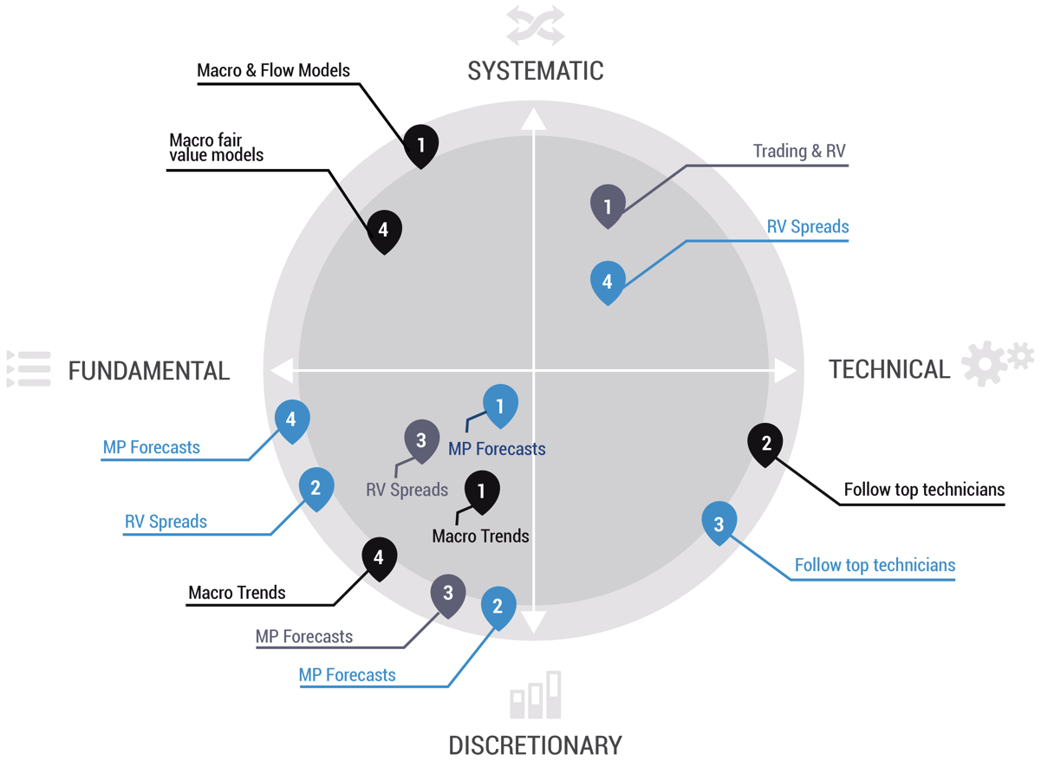
INVESTMENT MANAGERS’ EDGE – STYLES FOR ADDING VALUE
INVESTMENT MANAGER
1. Alexander Melsom, Investment Manager
2. Ronny Eriksson, Investment Manager
3. Anders Haller, Investment Manager
4. Bjørn Roger Wilhelmsen, Chief Economist
TIMEHORIZON
Long term / strategic > 3 month
Medium term < 3 month
Short term / trading intensive < 2 week

Slide 19
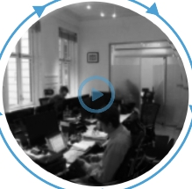
THE INVESTMENT PROCESS *
Economic update
Market flows
External market rrevieweports
Portfolio & risk review
Game plan
MARKET MONITORING
Daily meetings
Market brief (CE)
Portfolios (IM & RA)
INVESTMENT IDEAS
Asset allocation and
screening (CE & IM)
Experience
Market exp. vs. forecasts
Fair value models
Relative value models
Technical indicators
Cost efﬁcient implementation
Trade execution platforms
Portfolio mgt systems
Game plan entry
TRADE & GAME PLAN
Implementation (IM)
STRATEGY SELECTION
Limited sub-strategies
(CE & IM)
Expected return vs. vol
Market positioning
Correlations
Carry & roll analysis
RISK ASSESSMENT
Veto right (RA)
Risk mandates
Risk contribution
Internal risk systems
* This process also applies to individual mandates (Edge), except for the role of CE.
External risk & compliance by The Financial Compliance Group (FCG)

Slide 20
A PRE-DEFINED GAME PLAN
POSITION PLAN,
CONTENT & INPUT
- Rationale behind each position (ex ante)
- Expected holding period
- Return target
- Volatility, correlation & speciﬁc risks contribution
- Add & reduce levels
- Stop loss levels
- Evaluation of positions (ex post)
« TAGGING »
ALL STRATEGIES
- Portfolio segment
- Product/Instrument
- Decision maker/Investment Manager
- Investment styles/Strategies
« LIVE »
ATTRIBUTION
- Attribution tools & reports
- Full historic database
- «Live» screen attribution
- Full control in all scenarios
PURPOSE:
Maximizes risk/return
by ensuring discipline,
focus and transparency
in the investment process.

Slide 21
ABOUT OUR SELECTED THIRD PARTY PARTNERS
Custodian and Prime Broker:
SEB I www.sebgroup.com SEB has been market leader in Custody/PB for alternative investment funds since 1996
The Financial Compliance Group I www.fcg.se
FCG specializes in external compliance and risk management for onshore investment managers.
Founded in 2008, the ﬁrm employs 35 specialist consultants.
External Compliance Ofﬁcer: Jesper Dahllöf, senior manager at FCG
External Risk Manager: Mikael Olausson, manager at FCG
Wahlstedt Sageryd Fin. Services I www.ws.se
WS is the largest provider of external back ofﬁce services in Sweden.
Founded in 1991, WS employs 40 FTEs specialized in backofﬁce services for onshore funds.
Ernst & Young I www.ey.com/se
External Auditor: Jesper Nilsson, Partner at Ernst & Young Stockholm
PriceWaterhouseCoopers I www.pwc.se
Internal Auditor: Sussanne Sundvall, Partner at PWC Stockholm
Gernandt & Danielsson I www.gda.se
External lawyers: Nils Unckel, Lawyer & Associate / Niclas Rockborn, Lawyer & Partner GDA
Advokatﬁrmaet BA-HR DA I www.bahr.no
External lawyer: Markus Heistad, lawyer at BA-HR
ATEA I www.atea.com
Atea is the leading Nordic and Baltic supplier of IT infrastructure
Bloomberg AIM I www.bloomberg.com/aim
AIM is a world-leading integrated portfolio and trading STP system
External Compliance and Risk:
External Backofﬁce:
External Audit:
Internal Audit:
Legal Council Sweden:
Legal Council Norway:
IT infrastructure:
Portfolio & trading system:

Slide 22
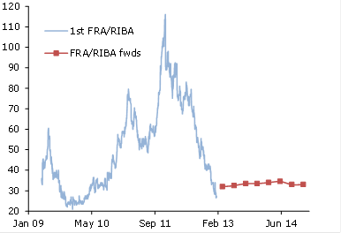
Position/Trade example: Wider TED-spread basis
Market view
- LTRO program will not be extended
- Prepayment-risk of LTRO-program, due to high excess market liquidity and contracting credit spreads
Strategy Selection
- Rationale: Bank funding and Euribor/Stibor fixings to increase. FRA/RIBA curve trades to flat
- Trade selection: Red SEK FRA to underperform Red SEK RIBA
Trade Implementation
- Pay Sek FRA MAR14 vs Rec RIBA JUN14 @ 32 bp
- Target 50 bp, Stop 20 bp, Horizon 6-9mth
System Tagging
- A.Haller, Edge, Fixed Income, RV-Spread, Market Interest Rate Risk
29

Slide 23
Position/Trade example: Steeper 2 vs 10 yr SEK govt asw box
Market view
- Diminishing demand for longer 10yr AAA/aaa SEK govt bonds from real money and foreign investors
- No issuance from SNDO of 2yr bonds
Strategy Selection
- Rationale: Asw curve to flat
- Trade selection: Receive 2yr SEK govt asw vs Pay 10yr SEK govt asw, risk neutral
Trade Implementation
- Pay 2 vs 10 yr asw box @ -2 bp,
- Target 15 bp, Stop -10 bp, Horizon 3mth
System Tagging
- R Eriksson, Strategic, Fixed Income, RV-Spread, Market Interest rate risk
30

Slide 24
Position/Trade example: EURNOK fx spot
Market view
- Underperformance of NOK vs EUR has gone too far according to a macrofundamental model
Trade Implementation
- Sell EUR/NOK spot at 7.90
- Target 7.70, stop 8.05
- Horizon 3 months
System Tagging
- BR Wilhelmsen, Strategic, FX, Outright, currency risk
31

Slide 25
Position/Trade example: Macro model
Market view
- Short US 10 year bonds based on model signals
Trade Implementation
- Short TYM3, or short tilt on other directional positions
System Tagging
- A Melsom, Edge, Fixed Income, Outright, Market Interest rate risk
32

